Slide 1
Olympian Gods and Goddesses

Slide 2
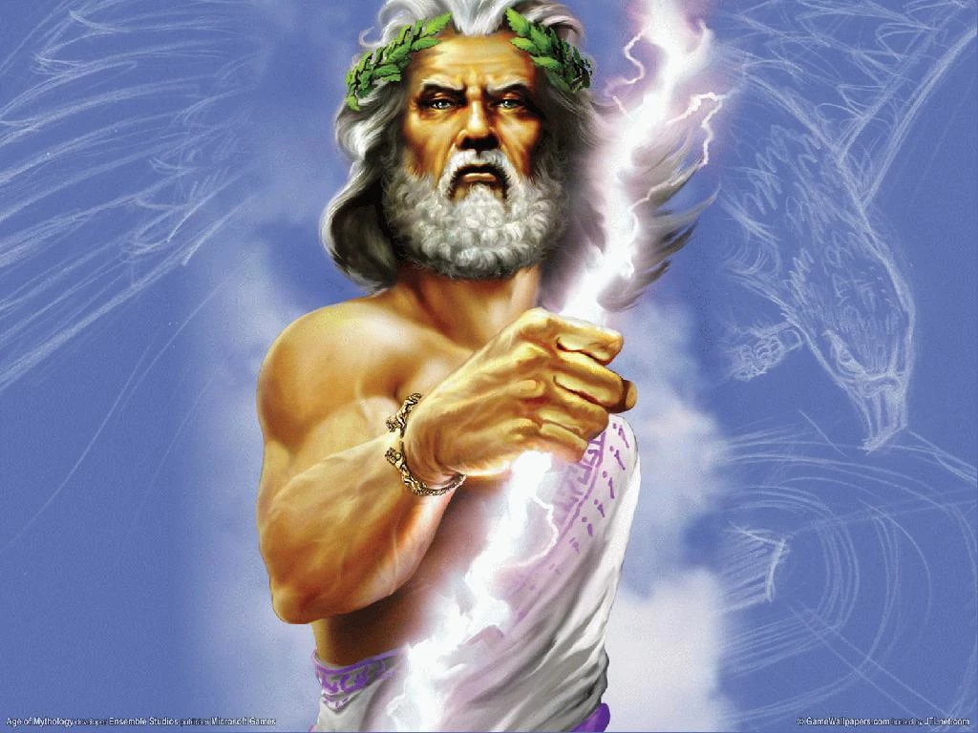
ZEUS ~ King of the gods!
God of heaven and earth

Slide 3
Aphrodite
Goddess of beauty and love

Slide 4
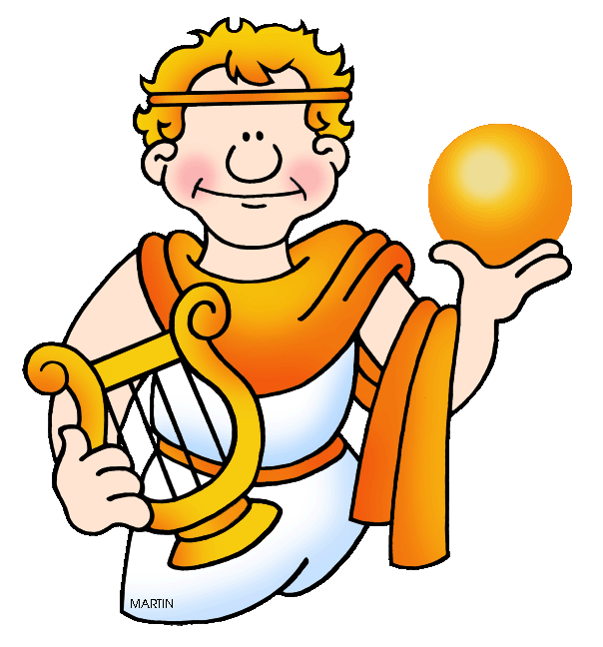
Apollo
God of music

Slide 5
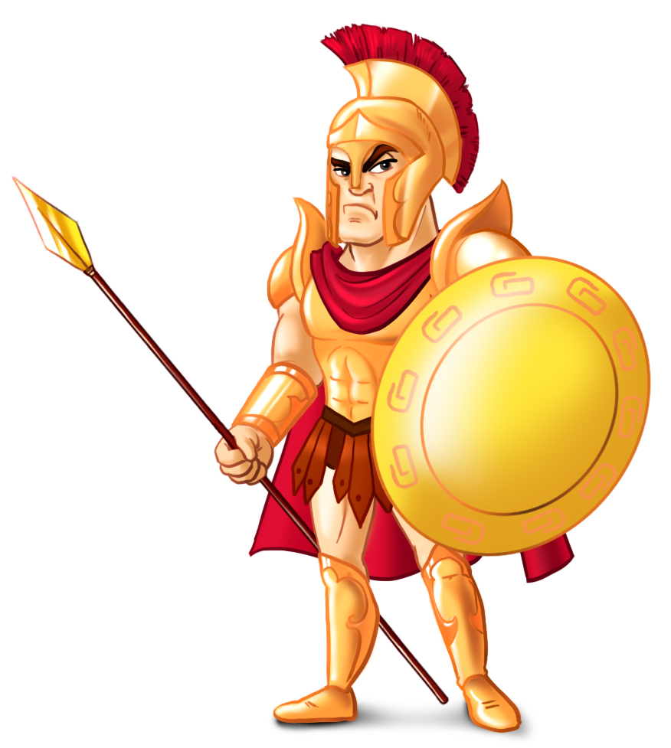
Ares
God of war

Slide 6
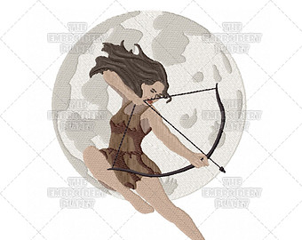
Artemis
Goddess of the moon

Slide 7
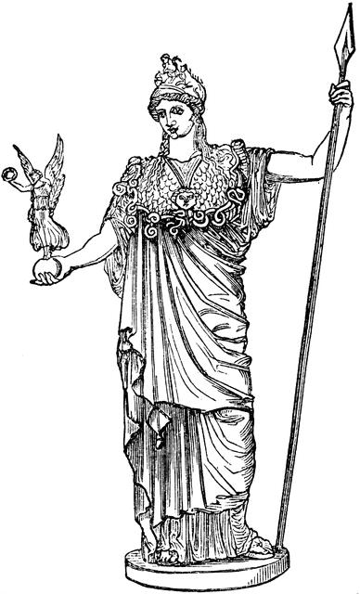
Athena
Goddess of wisdom

Slide 8
Demeter
Goddess of crops

Slide 9
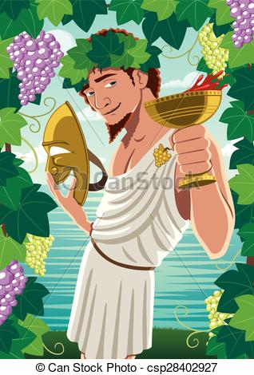
Dionysus
God of fertility

Slide 10
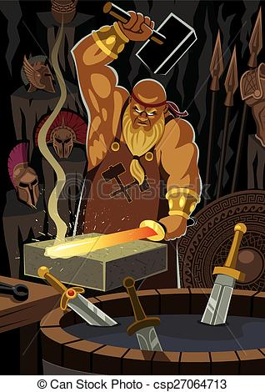
Hephaestus
God of artisans and blacksmiths

Slide 11
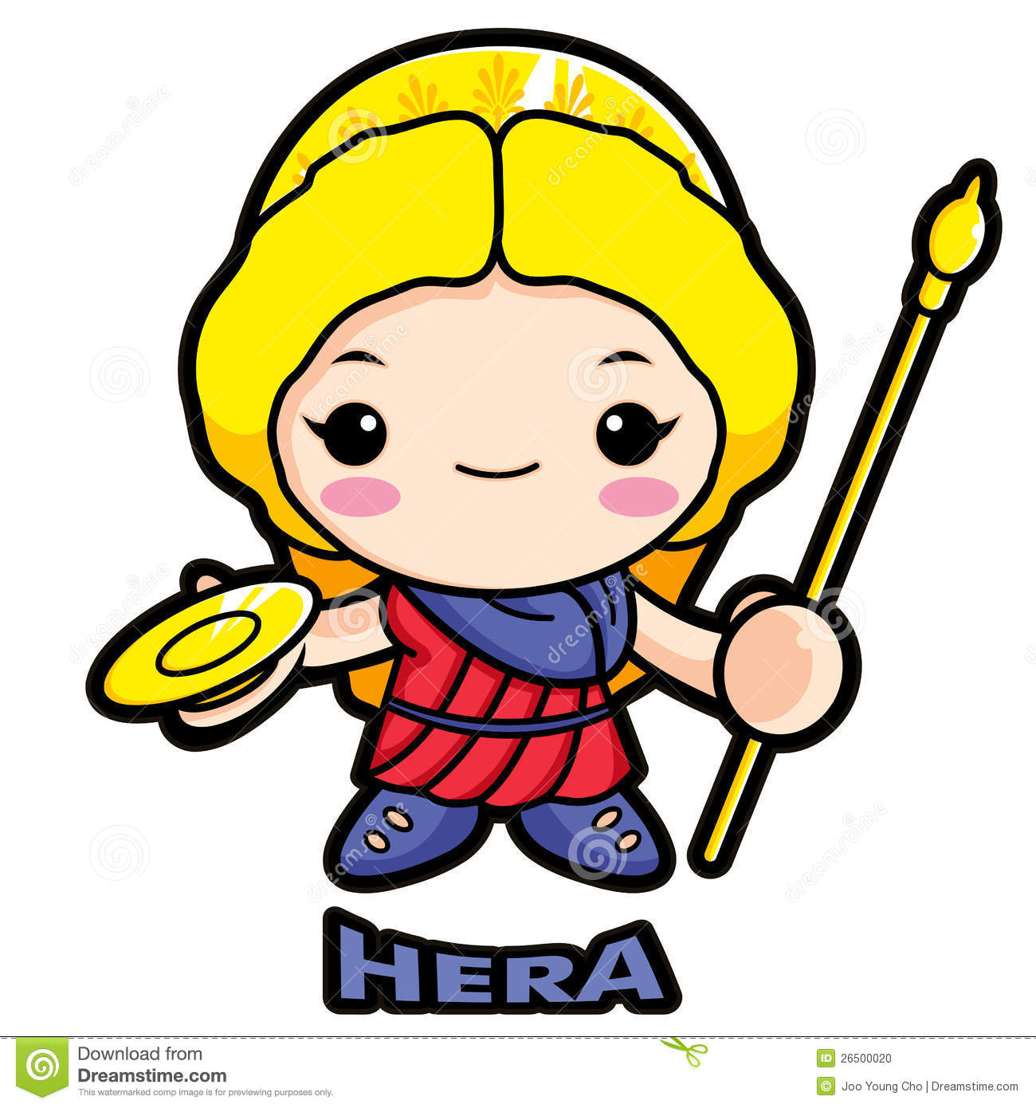
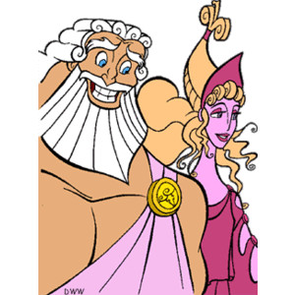
Hera
Goddess of marriage

Slide 12
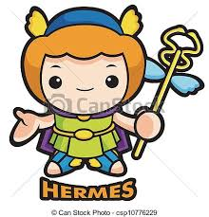
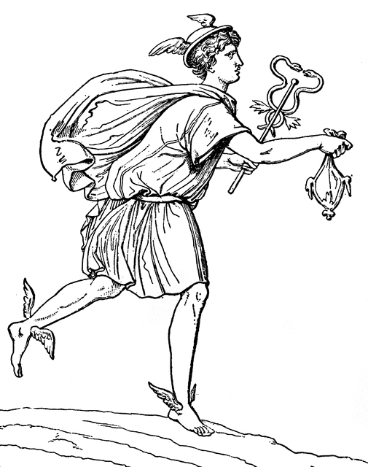
Hermes
God of travel and trade

Slide 13
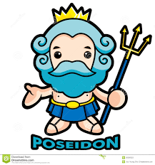
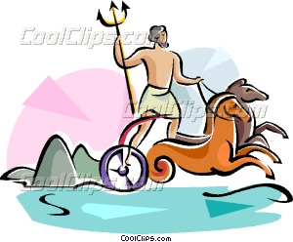
Poseidon
God of the sea and earthquakes

Slide 14
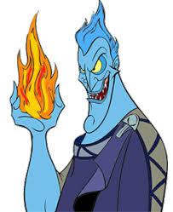
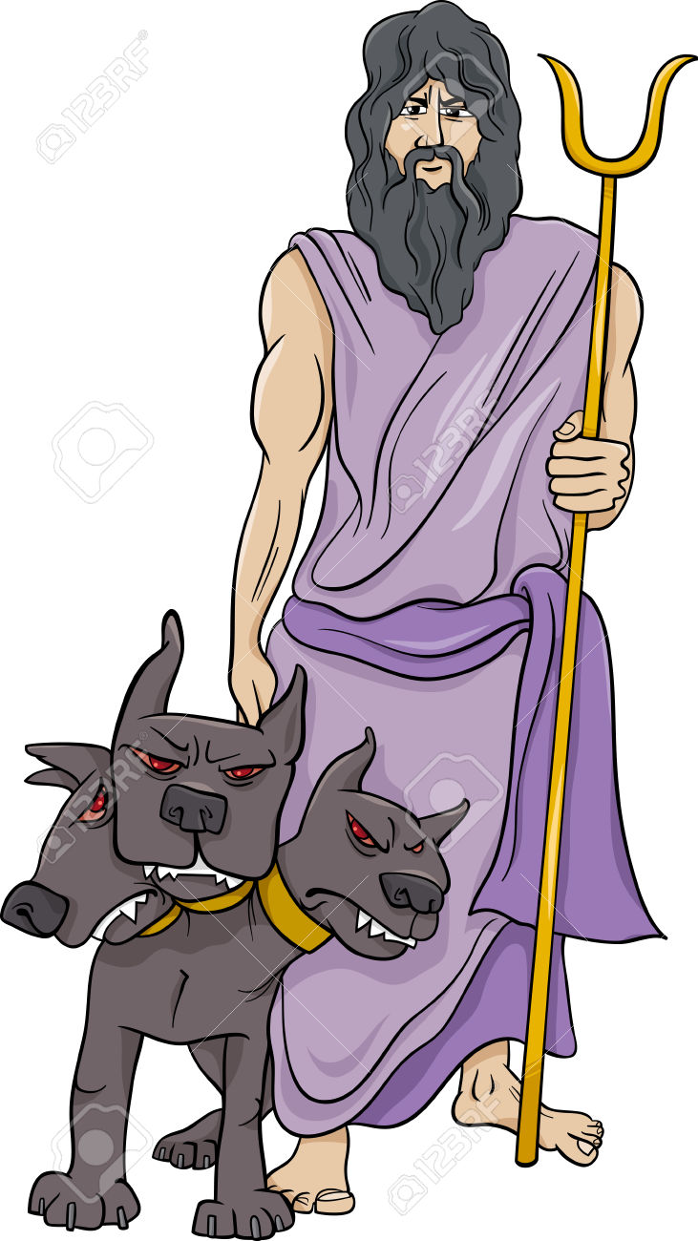
Hades
God of the Underworld

Slide 15
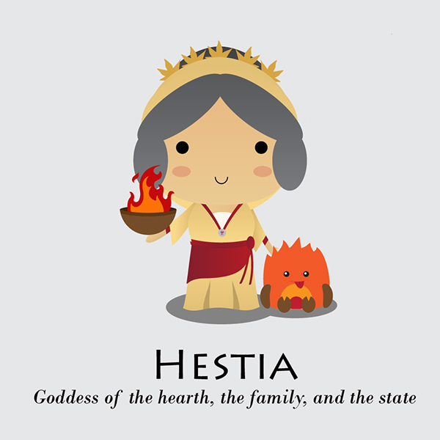
Hestia
Goddess of the home

Slide 16
